Slide 1
Good Afternoon, 810
This afternoon we will examine real life factors that affect the likelihood of having an interaction with the police. We will do this by:
Investigating the theoretical probability of being stopped randomly by police
Design a spinner experiment to compare theoretical probability to relative frequency
Compare relative frequency to real life statistics!

Slide 2
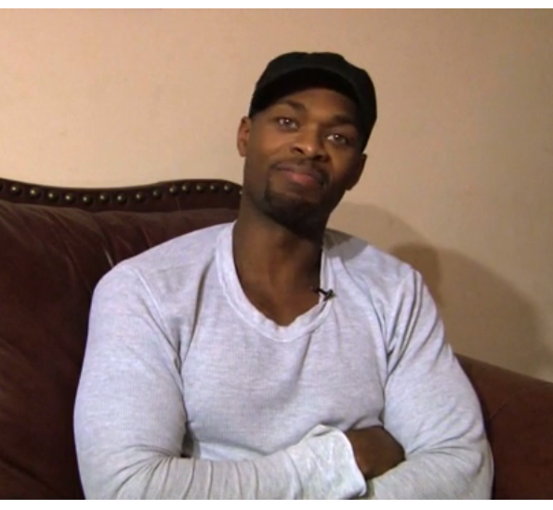
“We’re Looking For Someone Who Matches your Description”
Let’s watch this graduate of York University tell his story…
http://genychances.com/ → race → beginning to 1.37

Slide 3
Carding… What is It?
http://www.thestar.com/news/gta/knowntopolice.html (up to 2:02)

Slide 4
Population in Toronto, by Ethnicity
Source: 2011 National Household Survey
Statistically, how many people is that out of 100?
If “carding” is random, what is the probability of a person from each group being “carded” by police

Slide 5
How could we find the relative frequency?
Black = 8/100
South Aisan = 16/100
White = 53/100
“Other” = 23/100
Design an experiment…
what materials will you need?
What will you need to do?
How will you record your results?

Slide 6
In Real Life…
http://www.thestar.com/news/gta/knowntopolice.html (after 2:02 – watch the rest)

Slide 7
In Real Life…
According to results from a recently made Freedom of Information request: “While blacks make up 8.3 per cent of Toronto’s population, they accounted for 25 per cent of the cards filled out between 2008 and mid-2011.
In each of the city’s 72 patrol zones, blacks are more likely than whites to be stopped and carded. The likelihood increases in areas that are predominantly white.”

Slide 8
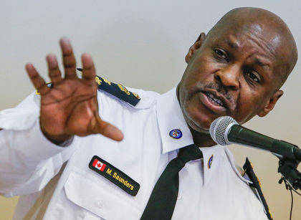
Should Carding be “Random”?
Saunders said he wants "to eliminate the word 'random'" from the police lexicon, referring to the city's controversial carding policy, which allows officers to collect information from residents even if they have committed no offence.
There is no reason that word should be in the police lexicon, he said.

Slide 9
The Facts on “Crime”…

Slide 10
Life is not Random!
Learn more about how gender, ethnicity, sexual identity and other factors affect your future: #whatarethechances

