Slide 1
We are learning to classify quadrilaterals by geometric properties such as parallel and perpendicular sides, lines of symmetry and angle size. We are also learning to perform and describe rotations.

Slide 2
Geometry
This morning we will we constructing polygons using twizzlers!
You may work alone, or choose a maximum of TWO partners who has a similar level of understanding to you in geometry. You will need:
A math dictionary
A protractor
Clean hands and two paper towels
A few short, and a few long twizzlers (Ms. T will hand these out once you have your paper towels on your table)
(LATER – NOT now!!) a device on which to record your work

Slide 3
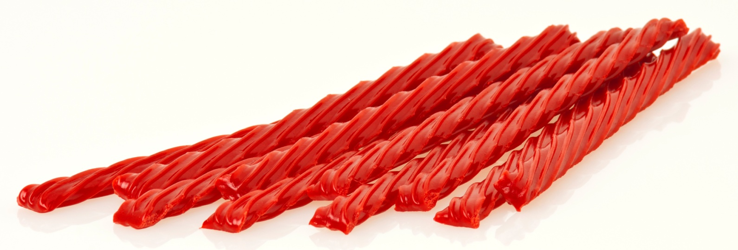
What shapes can you build with exactly two identical long Twizzlers and two identical short Twizzlers?
Once you have built several polygons, please check the assignment on Edmodo.

Slide 4
Edmodo Twizzler Assignment
Using Thinglink, Skitch, Flipagram, or some other appropriate app, create a visual to show what you know:
include at least two of your Twizzler Polygons
Include a caption that tells what each polygon is called (i.e. “parallelogram”, “trapezoid”, “concave quadrilateral”, etc.)
Label 5 different types of angles on your image
BONUS: What if you rotated one of your polygons 90 degrees clockwise? What would it look like?
Submit your assignment on Edmodo (one per group – but list everyone’s name!!!)
Be sure to save your file in a way that you can attach it, or “share” your file publically and publish it online, so that you can attach the link

