Slide 1
Digital Citizenship: Before you BYOD
Part One – Understanding your Digital Footprint, Respectful Use of BYOD

Slide 2
What is “BYOD”?

Slide 3
What are some benefits to BYOD?
What are some cautions?

Slide 4
Placemat
Person D, please come up and get a chart paper for your group.
If no one at your table group has markers they are willing to share, please send person A to go and get some.

Slide 5
Placemat
Have person C draw a box in the centre of your group’s chart paper.
Person C then draws lines out from the centre so that there are THREE (3) or FOUR (4) individual spaces around the outside (depending on number of people in group)
Wait for further instructions.
Notes:
Get them to write down the first thing that comes to mind when they think about “math”

Slide 6
Find your spot on the placemat, and write your name in it.
Think first…,
…then write down 3-5 pros and cons of BYOD.
(You may wish to use a “fishbone”.)

Slide 7
Person B in each group, please turn the place mat one quarter clockwise.
Everyone read what your neighbour wrote. If you agree, mark a little star next to the word or comment. If you have a question, write it down in that section of the placemat.
Once everyone has had a chance to read and comment (silently) on the section, Person B will turn it a quarter turn again, and the process will repeat itself.
Keep turning, reading and commenting on the placemat until everyone in the group has had a turn to read everyone else’s section.

Slide 8
Take some time to talk about what your group noticed…
Were there words or ideas that came up more often then others?
Why do you think this might be?
As a group, agree on your top three benefits and top three cautions
Person A, please create a “fishbone” in in the centre of your group’s placemat.

Slide 10
What are some benefits to BYOD? What are some cautions?
BENEFITS
THINGS TO CONSIDER:

Slide 11
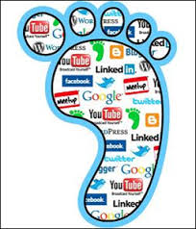
Consider this: Everything you do online is eternal…

Slide 12
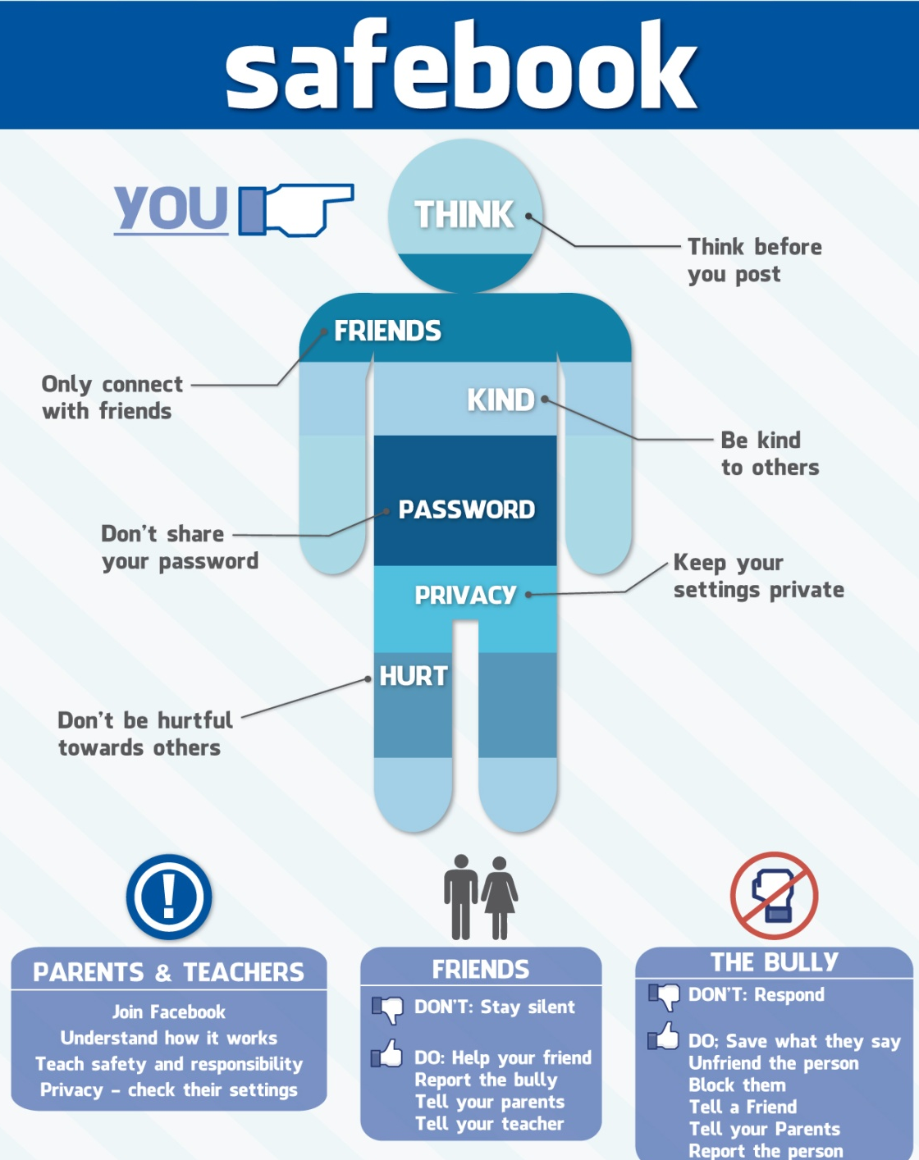
Is this YOU? HOW & WHEN do you use social media? PAUSE & THINK

Slide 13
What Digital Footprint do You Leave Behind?
Passwords
Websites
Postings Photos
Texting
Emailing
Blogging

Slide 14
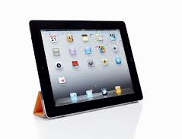
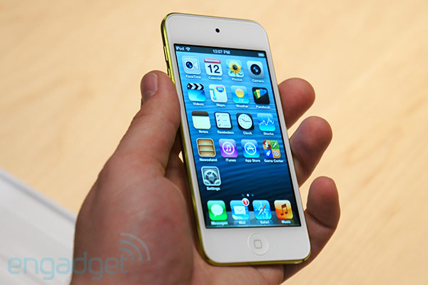
APPROPRIATE BYOD DEVICES AT TOMKEN
Laptop
Ipad
Tablet
IPOD

Slide 15
Sorry, no phones ☹

Slide 16
BYOD WILL BE...
Teacher directed
For educational purposes only

Slide 17
“RIGHT TIME, RIGHT PLACE”
Devices may only be used in learning environments where students are actively supervised by Tomken staff.
classrooms
library
outside of the classroom when directly supervised by a staff member

Slide 18
“RIGHT TIME, RIGHT PLACE”
BYOD Devices may not be used...
during class transitions (Hallway)
in the cafeteria during lunch
on school property outside of the buildings during recess
in the gym or change rooms
on any field trips unless special permission is granted

Slide 19
BYOD NORMS
What agreements can we make to ensure BYOD is safe, effective and respectful?
Person C, please get a chart paper for your table group
Person B, please scribe as your group brainstorms some guidelines.
Discuss your ideas as a group, then agree on 2-3 to share with the class.
Remember to Pause, Paraphrase & Probe! ☺

Slide 20
BYOD NORMS
Always keep your device in full view
When your device is not in use, keep it face-down on your desk/work area
Devices should be on silent mode
Keep passwords PRIVATE
Headphones are helpful when working
ANY OTHERS???

Slide 21
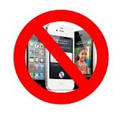
Inappropriate use may result in...
Temporary loss of privileges

Slide 22
Great ways to integrate technology in the classroom

Slide 23
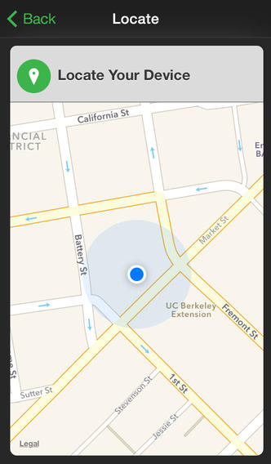
Free Anti theft APPS available to protect your devices!
Some Apple, Android and Blackberry Apps Available:
Bit Defender, Prey, Lookout, Find My Ipad, or Blackberrry Protect are a few examples of anti-theft apps

Slide 24
We Are Tomken
We build our community through thoughtful actions.
We include all and respect our differing opinions and cultures.
We work cooperatively to become our best.
We grow as we allow each person the room to error and understand that each of us is doing our best and wanting to be accepted.

Slide 25
THANK YOU
Part Two will include
Cyberbullying, Digital Compass and your “Digital Drivers’ Licence/Test”!

