Slide 1
Digital Citizenship: Before you BYOD
Part TWO – Cyberbullying, Digital Compass, “Licence/Test”!

Slide 2
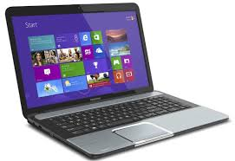
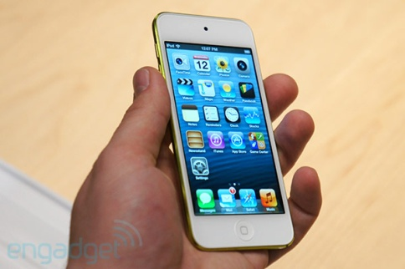
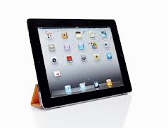
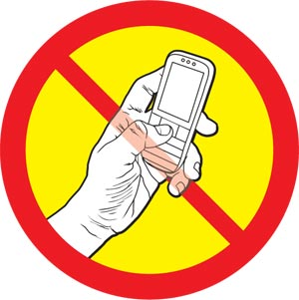
Remember???
What can be used?
When and where?
Classroom
Library
With staff supervision/ permission

Slide 3
Quick Review
What do you remember about BYOD use and norms?

Slide 4
What is a “Digital Footprint”?
Passwords
Websites
Postings Photos
Texting
Emailing
Blogging

Slide 5
BYOD WILL BE...
Teacher directed
For educational purposes only

Slide 6
BYOD Norms...
Where are they posted?

Slide 7
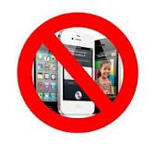
Inappropriate use may result in...
Temporary loss of privileges

Slide 8
Digital Compass
To help you navigate…
?
?

Slide 9
Cyberbullying
Character, Values, the Law

Slide 10
CYBERBULLYING…
Are you Informed?
Are you involved?
Are you responsible?

Slide 11
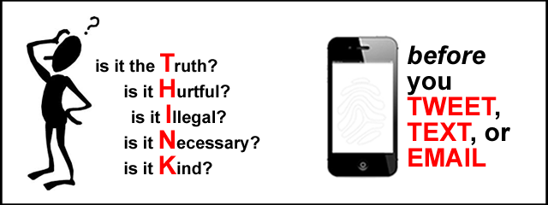
Tomken Road Middle School Use of Technology Code of Conduct
Students may be held responsible for any home computer or internet activities unauthorized by the school.
Sending or displaying offensive messages, pictures, videos, or insulting, or harassing, or attacking others is not permitted.
Using obscene or racist language/images in public or private messages.

Slide 12
The Police & The Law
Internet Safety Committee

Slide 13
Expectations + Character
It is our character and values,
our sense of what is right,
our courage to make the right decision, even in the face of peer disapproval,
our empathy for the person being targeted

Slide 14
Plagiarism
What? How?

Slide 15
What is Plagiarism?
Copying/using images, text, ideas without referencing the source
The Internet is not “free for all”

Slide 16
Sooo… What can you do?
Ask permission
Reference (caption, link to site, etc.)

Slide 17
Privacy and the Internet
Be careful, be safe!

Slide 18
Privacy & the Internet
(There is none!)
This is a money making business. You are the target market.
Facebook, Twitter, YouTube, emails are all traceable even when deleted.
What you work on privately is not private on the internet.

Slide 19
But even if there were Privacy…
Character is about doing the “right” thing, even when you think no one is watching!!!

Slide 20
We Are Tomken
We build our community through thoughtful actions.
We include all and respect our differing opinions and cultures.
We work cooperatively to become our best.
We grow as we allow each person the room to error and understand that each of us is doing our best and wanting to be accepted.

Slide 21
THANK YOU!
Digital Driver’s Lisence

