Slide 1

WELCOME!
Math as a Vehicle for Social Justice
with Vera C. Teschow
PUBLIC version
with student photos
removed – please
credit V. Teschow
when using material
Notes:
Meet and greet participants as they arrive.

Slide 2
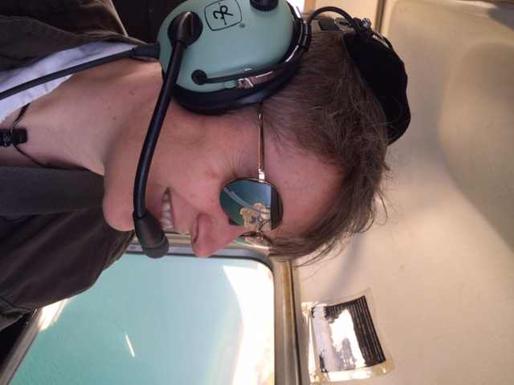
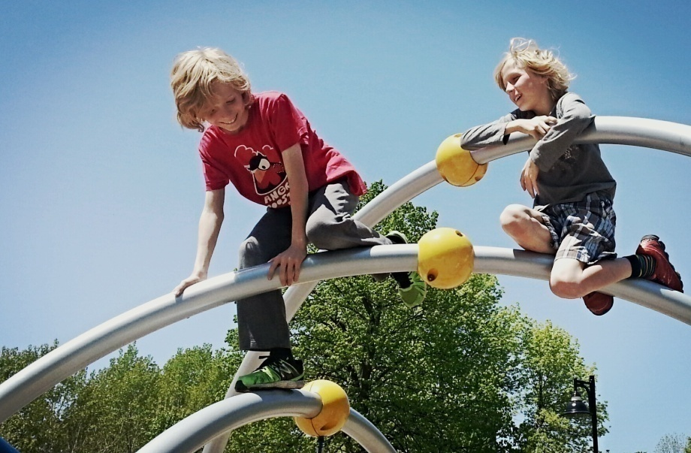
Your Presenter
Classroom Teacher, Pilot Mother of Twins

Slide 3
“Shoe and Tell”
Notes:
Before we get started… turn to the person next to you and show them your shoes, tell them why you chose to wear those shoes this morning! ☺

Slide 4
Before anything else…
Notes:
Take a moment to letter off in your group…

Slide 5
Agenda
Intro
A Little Math
A few Stories from Vera’s Classroom
Time to Plan
Debrief and Share
(handout, pg 3!)

Slide 6
Minds On
Considering Issues and Defining 21C Learning

Slide 7
Why are you here today?
With so many excellent workshops to choose from, why this one? What are you hoping to get from today’s session?
  Turn and tell someone at your table group
  If comfortable, add you ideas to our group padlet at:
padlet.com/teschowv/ottawa

Slide 8
Objectives:
To review the concepts of Equity and Social Justice,
and define 21-C learning
To consider ways in which equity and social justice could be authentically built into junior-intermediate math lessons, using
a 21-C lens, or ways to develop math lessons that address issues of equity and social justice
To provide an opportunity to network and share resources with other colleagues interested in beginning to use or refining their use of 21-C Equity and Social Justice approach to teaching math

Slide 9

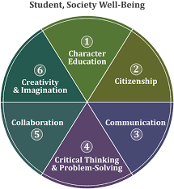
Defining 21-C Learning
(handout, pg 4!)

Slide 10
Action
Math, Classroom Vignettes, Considerations

Slide 11
A Little Math…
(handout, pg 5!)
Person in each group, please come and get a stack of newspapers for your table group
Take a few minutes to explore the paper; what do
you notice?
try out one or both activities from the handout

Slide 12
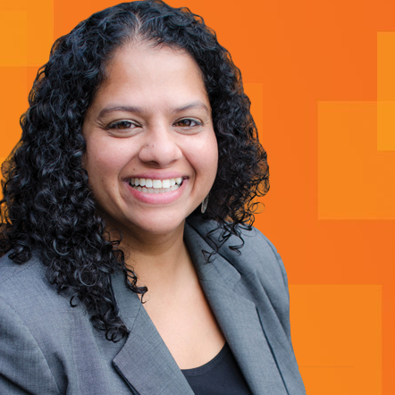
Real Life Data
(handout, pg 6!)
“The Negotiator”

Slide 13
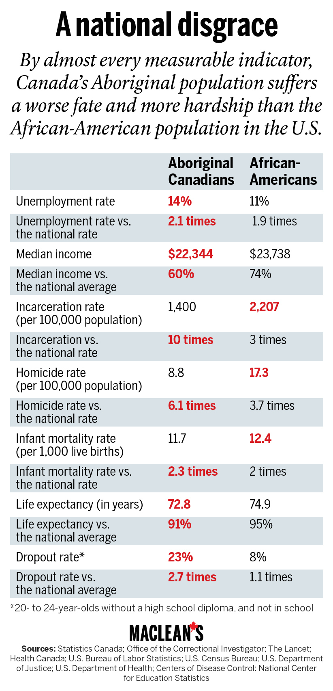
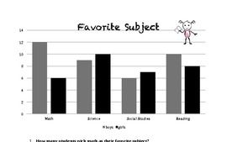

Introducing Data to Students
(handout, pp 7-9!)
Consider moving beyond the textbook…

Slide 14

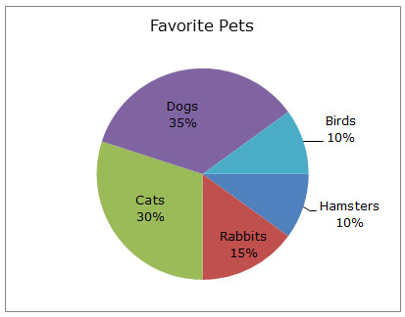
Introducing Data to Students
Consider moving beyond the textbook…

Slide 15
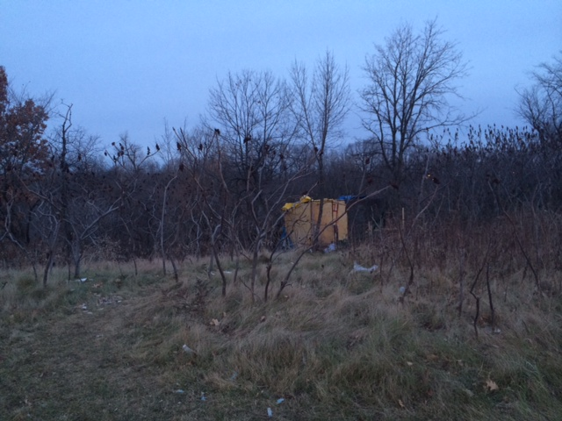
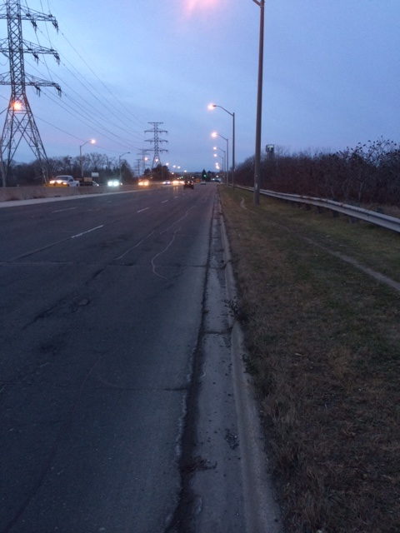
What do you see in the photo below?
“Many parts of Mississauga are “home” to people who don’t have a home, but instead take shelter in hidden places, like stairwells and doorways, around parks, railways lines, not far from your home, perhaps.” (Mississauga Life, 2011)

Slide 16
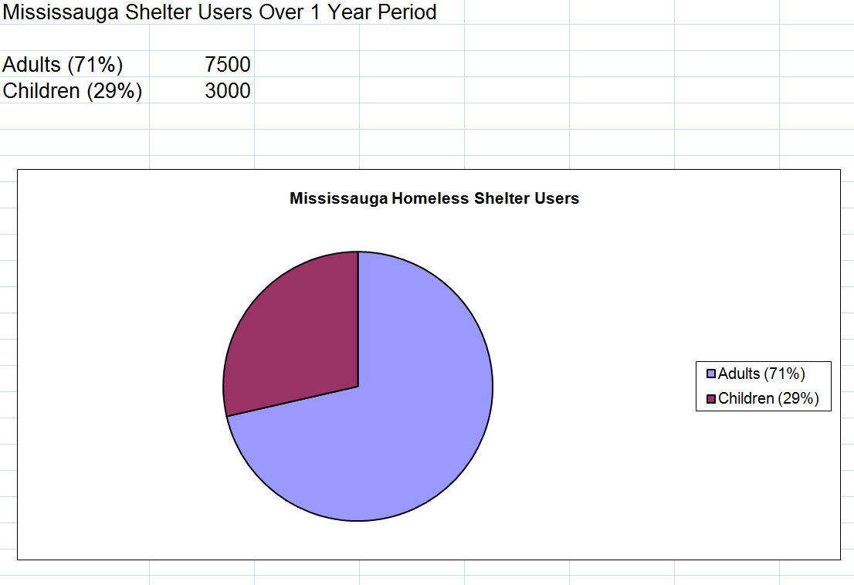
Mississauga Shelter Users

Slide 17
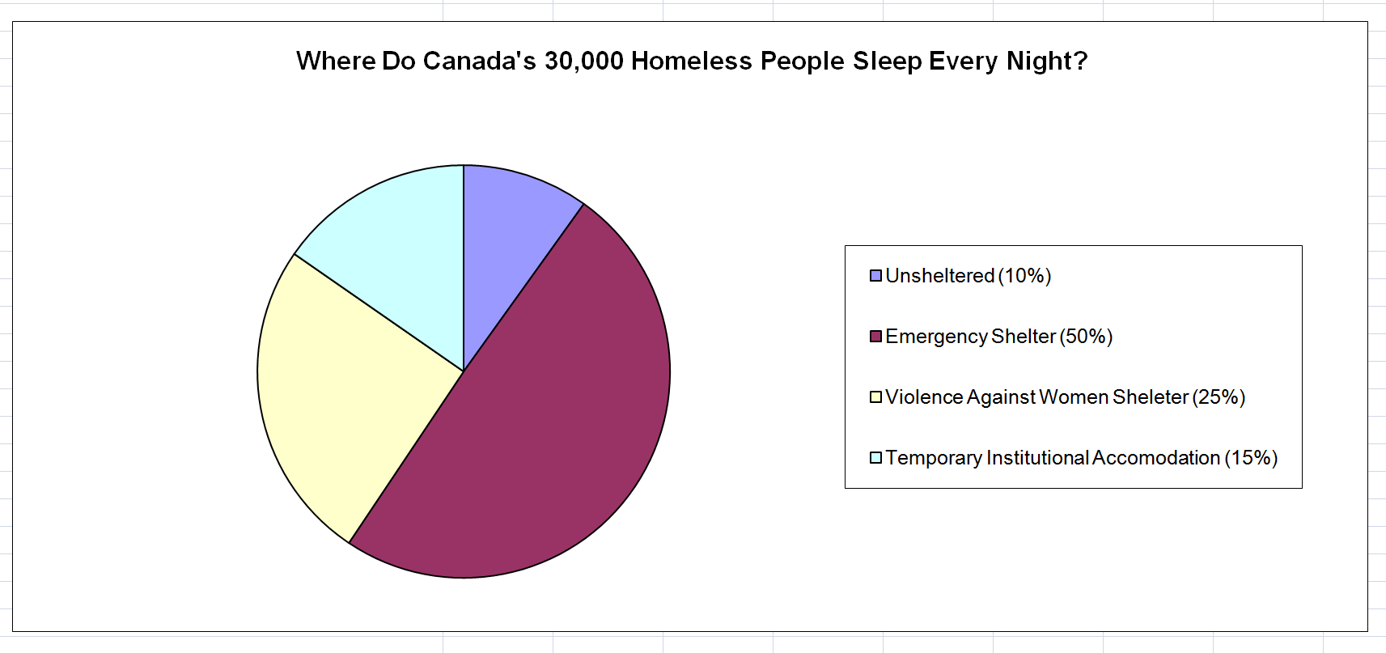
Where do Homeless Canadians Sleep?
How many people are homeless in Canada? Is this an exact or an “average” number? How do you know?
Approximately how many Canadians sleep on the street each night?
(Does “approximate” mean the same as “average”?)
What might be an example of “temporary institutional accommodations”?
BONUS: Find Two Spelling Errors!

Slide 18
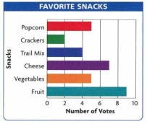
Data Management
More than your Favourite Snack!

Slide 19
Parts of a Graph
In your notebook, draw a rough sketch of this graph.
Label the following: Title, Key, Data
What kind of a graph is this? What other types of graphs are you familiar with? Why might people choose to show data this way?

Slide 20
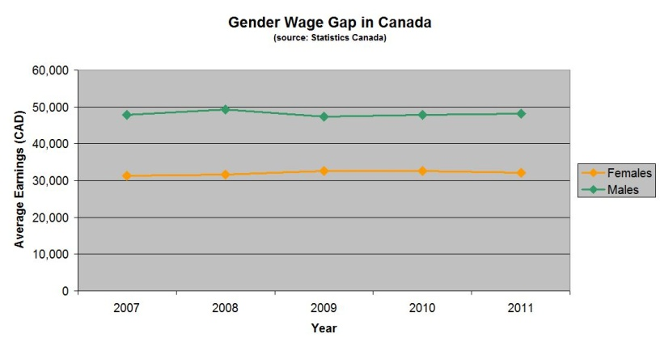
Real Life Data

Slide 21
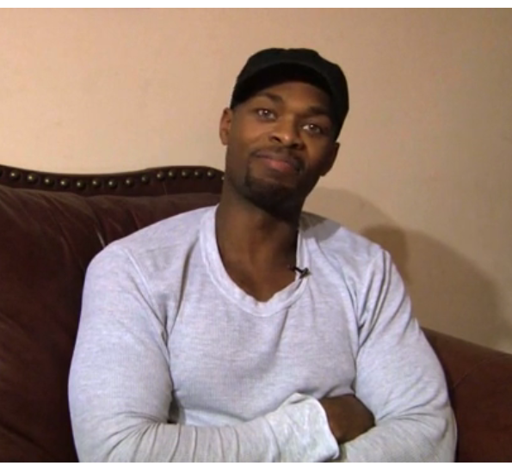
“We’re Looking For Someone Who Matches your Description”
Let’s watch this graduate of York University tell his story…
http://genychances.com/ → race → beginning to 1.37

Slide 22
In Real Life…
According to results from a recently made Freedom of Information request: “While blacks make up 8.3 per cent of Toronto’s population, they accounted for 25 per cent of the cards filled out between 2008 and mid-2011.
In each of the city’s 72 patrol zones, blacks are more likely than whites to be stopped and carded. The likelihood increases in areas that are predominantly white.”

Slide 23
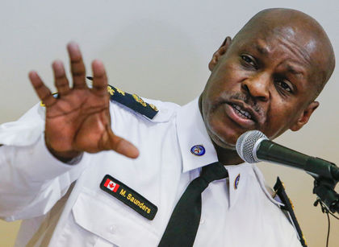
Should Carding be “Random”?
Saunders said he wants "to eliminate the word 'random'" from the police lexicon, referring to the city's controversial carding policy, which allows officers to collect information from residents even if they have committed no offence.
There is no reason that word should be in the police lexicon, he said.

Slide 24

The Facts on “Crime”…

Slide 25
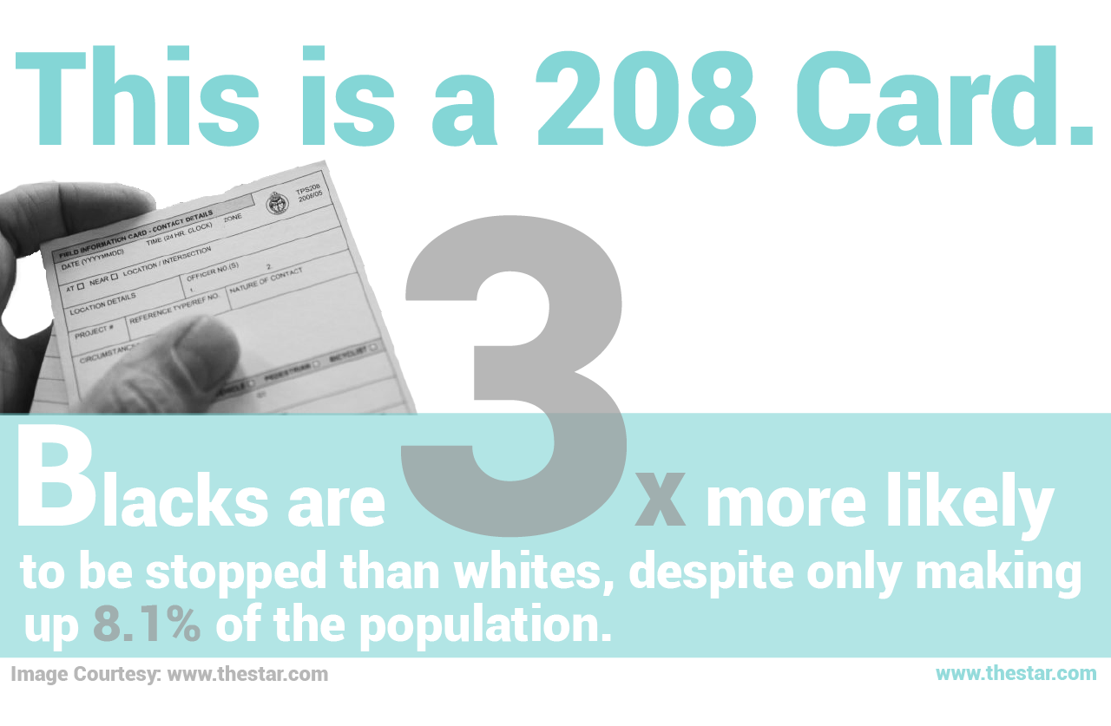
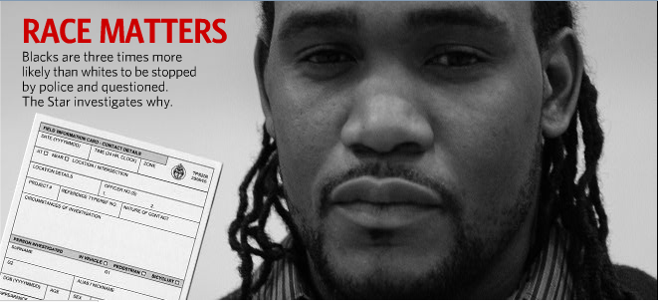
Life is not Random!
Learn more about how gender, ethnicity, sexual identity and other factors affect your future: #whatarethechances

Slide 26
Measurement and Mapping…
Samples on your desk
(page 10 in handout)

Slide 27
What’s the link to Equity and Social Justice?

Slide 28
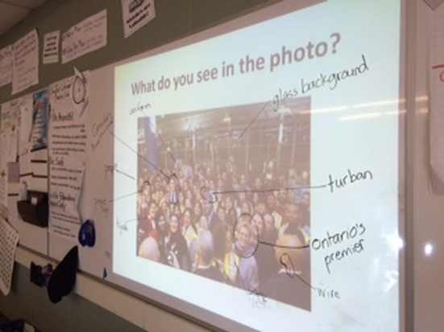
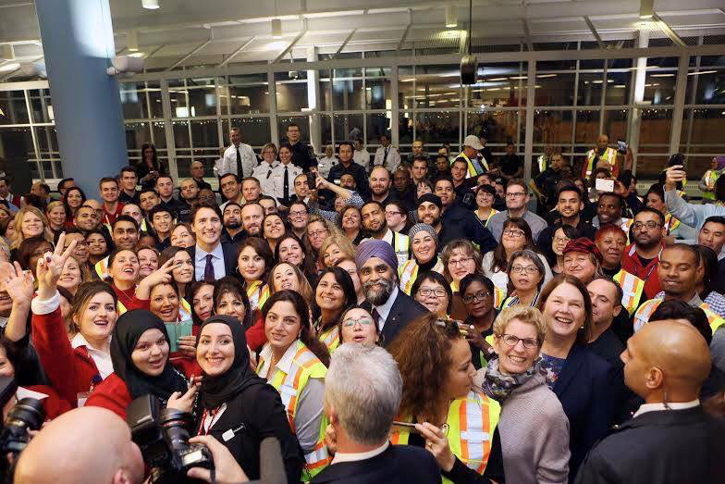
What do you see in the photo?

Slide 29
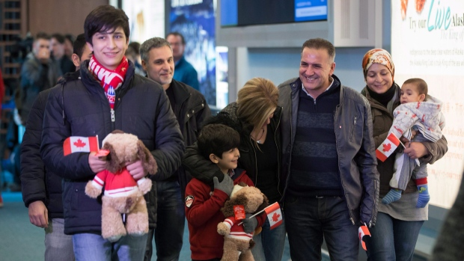
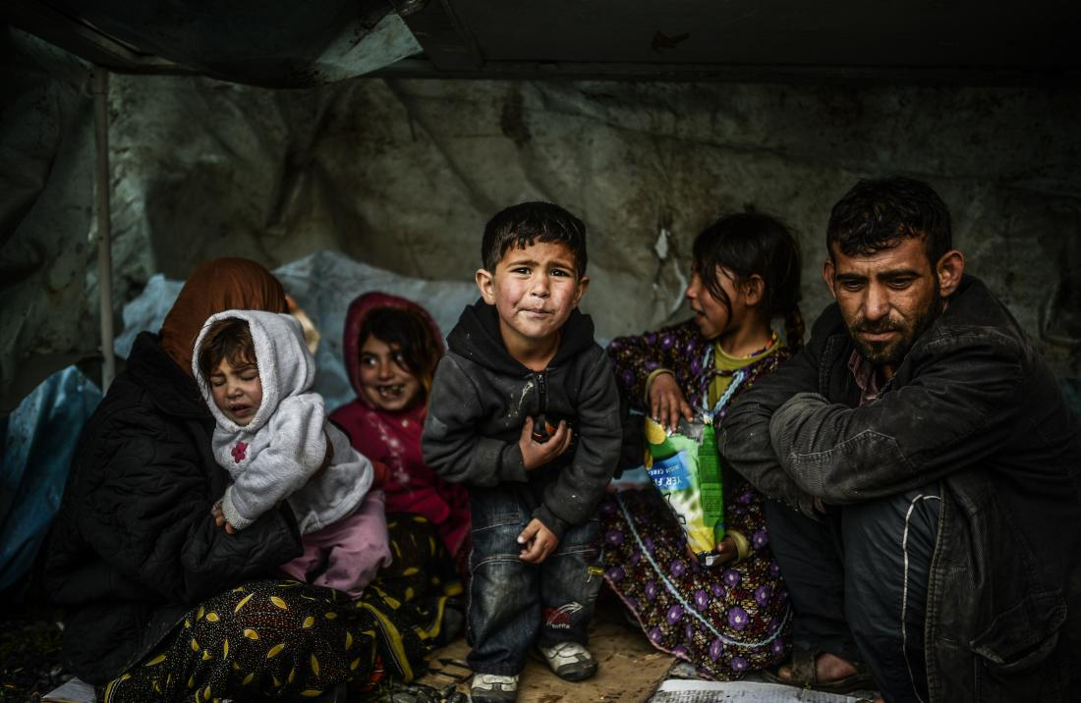
Here are two photos...
How do you think the people in each photo are feeling? Why? Who are they?
(TOP) Syrian refugee Mohammad Kurdi, third right, smiles while walking with his sister Tima Kurdi, centre, who lives in the Vancouver area, his wife Ghousun Kurdi, holding their 5-month-old son Sherwan Kurdi, right, and sons Shergo, 14, left, and Rezan, 8, centre left, after arriving at Vancouver International Airport in Richmond, B.C., on Monday December 28, 2015. (Darryl Dyck/THE CANADIAN PRESS)
(BOTTOM) AFP/Getty Images A Syrian refugee family from Aleppo stays under a shelter during a rainy day on March 8, 2014 in Uskudar, Istanbul.

Slide 30


What do you already know about...
Refugees (what is a refugee?)
Syria? Europe?
The Syrian refugee Crisis?
What Canada is doing to help?

Slide 31

Syrian Refugee Inquiry
(handout, pp 11-14!)
“We Walk Together…”
As we watch, what questions do you have?
http://www.theguardian.com/world/video/2015/sep/10/we-walk-together-a-syrian-familys-journey-to-the-heart-of-europe-video
Watch to :50

Slide 32
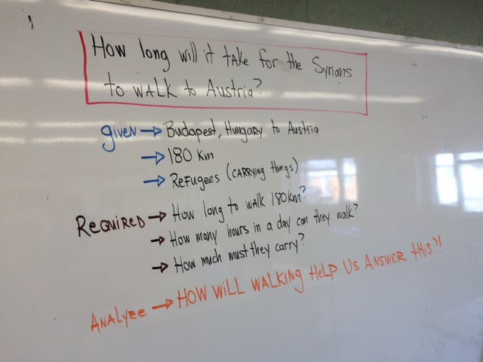

Slide 34
Checking in Enroute
Every 10 minutes:
  How are you feeling?
  How far have we gone?

Slide 35
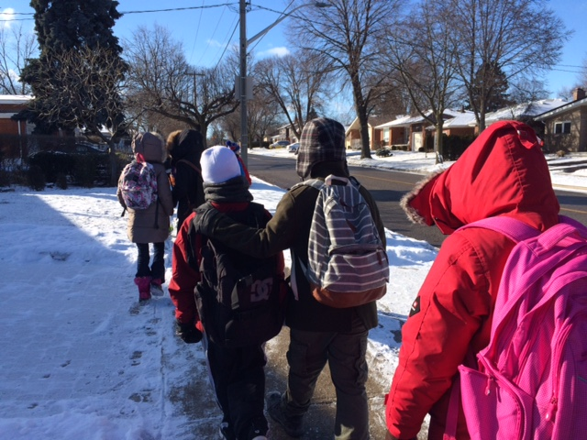
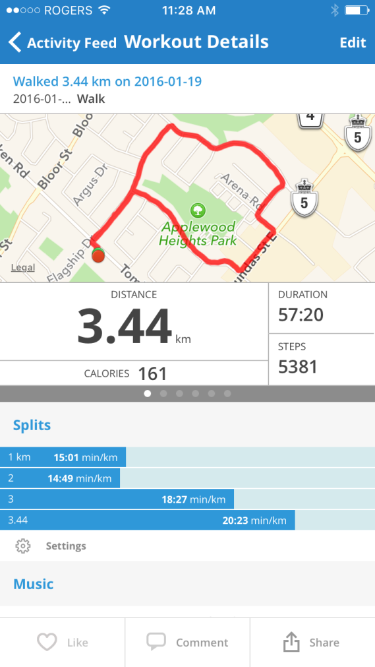

Slide 36
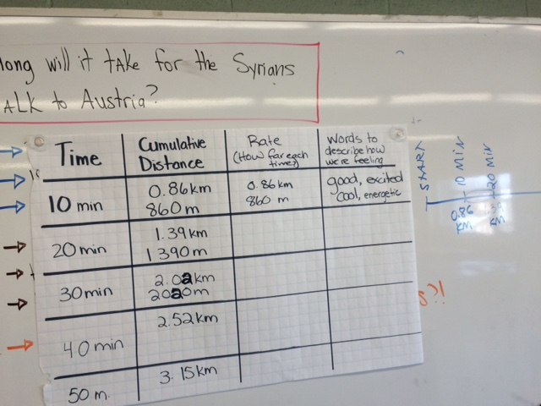
Where’s the Math?

Slide 37
Consolidate
Time for Planning

Slide 38

☺ Now YOU Try! ☺
(handout, pp 15-18!)
Try your hand at planning a lesson that integrates an Equity
or Social Justice issue, or one that uses this issue as its focus
Another option: Take an existing lesson you teach, and modify it to incorporate a social justice issue
You may choose to work alone, w/ a partner or as a table group
15-20 minutes

Slide 39
Debrief
Sharing Ideas, Questions, Concerns, Reflections

Slide 40
“Give One/Get One”
Affirmation – Something I already knew or believed that was confirmed for me in today’s session…
“A-ha!” Moment – Something new I learned today… Or, something I am excited to try out with my own students…
Question – Something I am still wondering about…
Find a coloured index card on your table
On one side, please number:
1.
2.
3.

Slide 41

Share your thoughts…
Same colour
Different colour
Choice

Slide 42

Questions? Comments? Concerns?

Slide 43
They are the future…
what schema will you help them to develop?

Slide 44
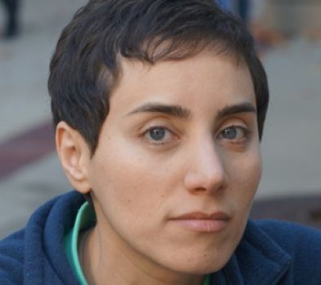
Maryam Mirzakhani
(Fields Medal Winner, 2014)
“Many students don't give mathematics a real chance. I did poorly in math for a couple of years in middle school; I was just not interested in thinking about it.
I can see that without being excited mathematics can look pointless and cold. The beauty of mathematics only shows itself to more patient followers.”

Slide 45
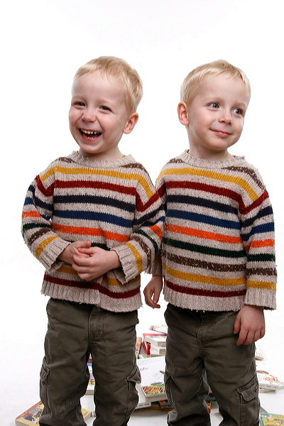

Thank you!

